Slide 1
Representing information CSCI 3002 Fall 2018
Notes:
Book page from Edward Tufte, Envisioning Information

Slide 2
This week
Welcome back!
We are now in the end stages of this course
Remaining topics: Covering emerging trends and issues in HCI

Slide 3
Schedule
This week: images and sound
Tue: Representing information visually
Thu: Using sound in UIs
Next week: social implications
Tue: Inclusive design and accessibility
Thu: Human values in design
Week after next: THE END
Tue: Project presentations (12/11)
Thu: Quiz 3

Slide 4
Brief recap of gestures
See slides from last week
What we covered:
Types of gestures
Sensing mechanisms for gestures
How to consider evaluating gestures
Ergonomics and social factors

Slide 5
Even more about gestures
What we didn’t cover
Inventing and evaluating gesture sets
Recognizing gestures
Gesture accessibility
For more info, see the slides, or CSCI 4849 next semester

Slide 6
Next up: info visualization

Slide 7
This is about user-centered design.
Notes:
View it big: https://upload.wikimedia.org/wikipedia/commons/2/29/Minard.png

Slide 8
The problem
How to represent information to the user
How we often encounter it: “Ack! Should this be a chart, a map, a timeline??” or “These are social media posts, so they should be in a timeline.”
How we should think about it: What is the user trying to accomplish and how can we put that information in front of them?

Slide 9
Why discussing in this class?
Graphical representations are a core part of most interactive systems
Most of the time we need to show “stuff” in our user interface
It’s important to tie the representation of information to user’s goals
“Human-centered information design”

Slide 10
Human-centered information design
What is the user trying to do?
Often about making a decision
What information do they need to make this decision?
How can we optimize finding this info and making comparisons?

Slide 11
Example
Let’s say we have a data set of pizza places in Boulder
What do people need to know?

Slide 12
Data about pizza

Slide 13
Questions that a pizza user might have

Slide 14
Data about pizza
Feature array (delivery, gluten free…)
Proximity to user (lots of ways to consider this)
Time representations
Quality (the best)
Categories, style
Menu items
Cost
Popular dishes

Slide 15
Pizza questions and solutions
Which places do people like?
Which ones are open when?
Do they deliver? Do they deliver for free? Do they deliver to where I am?
Vegetarian options? (gluten free, deep dish)
How much pizza can I get at once?
How soon can I have pizza?
Details about the venue: Dine in, carry out, etc., parking
Ambiance
How much it costs
How far is it from where we are
Health rating
Dating/Pizza meetup
Show ambiance, pictures

Slide 16
Common viz tasks
Making sense of information → exploratory data analysis
Comparison between variables
Optimization (based on some goal)

Slide 17
Perspectives
Edward Tufte
Background in statistics
http://edwardtufte.com
(OK summary at http://www.sealthreinhold.com/school/tuftes-rules/)
Bret Victor
Background in HCI
http://worrydream.com

Slide 18
Shorter Tufte
New tech sucks
Paper > screens
Screens should be more like paper
Don’t hide complexity or density
Put information up so people can make sense of it
No “chartjunk”

Slide 19
Napoleon’s March by Minard
https://robots.thoughtbot.com/analyzing-minards-visualization-of-napoleons-1812-march

Slide 20
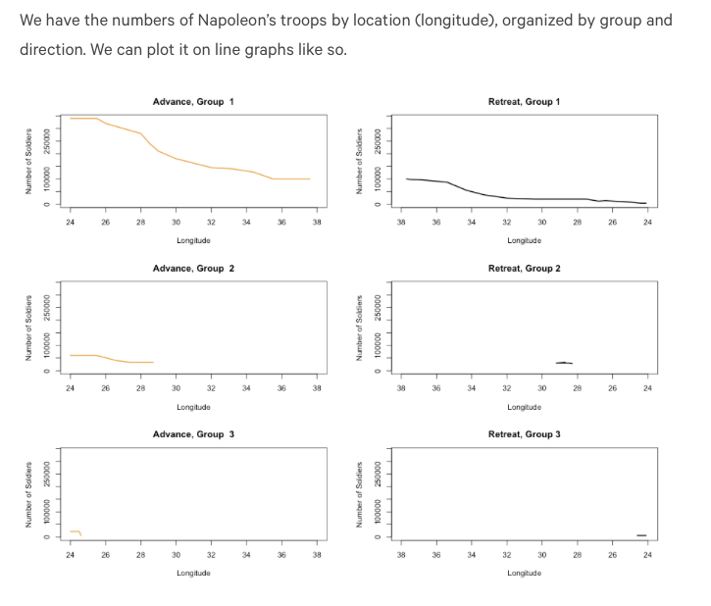

Slide 21
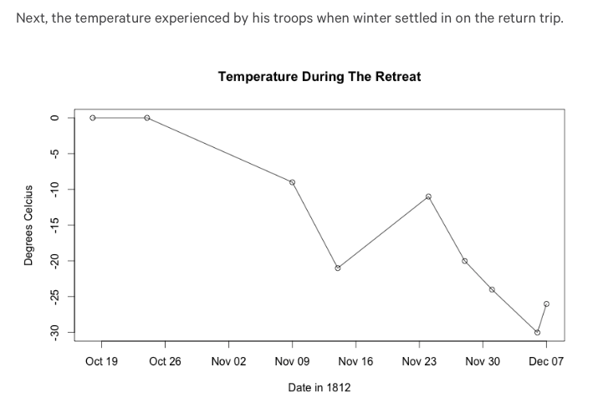

Slide 22
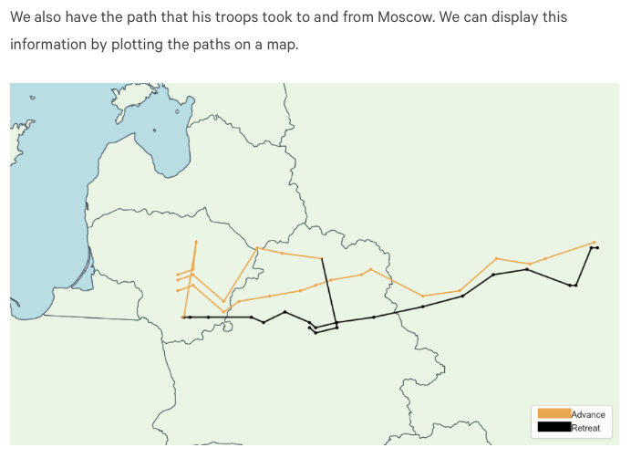

Slide 24
Why is this good? Is it good?

Slide 25
Some principles from Tufte
Use color, type, etc. wisely
Don’t assume mappings are intuitive
Be prepared for people to read into things that aren’t there
Include detailed data when possible
Leave out “chartjunk” – graphic elements that aren’t part of the content
Above all, remember the user’s purpose

Slide 26
Don’t hide detail
preserve gestalt,
but support detailed exploration

Slide 27
Eliminate
“chartjunk”

Slide 28
Consider color mappings
(or, really, consider every detail)
Notes:
from https://www.cs.uic.edu/~jbell/CourseNotes/Matlab/japan_sea.jpg

Slide 29
Bret Victor
Former interface designer at Apple
One of the original designers of the iPad UI
Focus on the future of interacting with information on screens

Slide 30
Summary of Victor
Use the modern tools we have available
Understand and use context where we can
Data exploration tied to HCI
“Dynamic pictures”, “explorable explanations”
Check out cool demos at worrydream.com

Slide 31
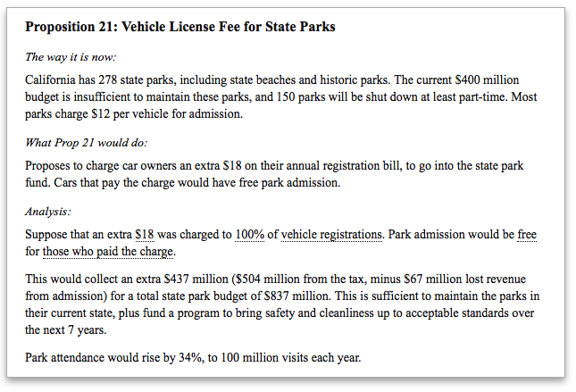
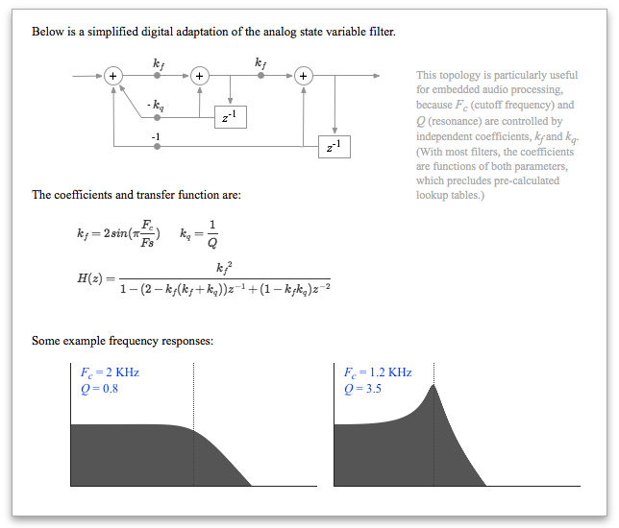
http://worrydream.com/ExplorableExplanations/
Notes:
Kind of like literate programming stuff.

Slide 32
Designing info displays

Slide 33
(Some) goals of information display
Provide an overview of the world
Allow comparisons
Show progress
Understand relationships
Motivate behavior
Test hypotheses

Slide 34
Our information design toolkit

Slide 35
Basic graphic representations
Charts
Maps
Timelines
Multiples
Photo collages
Treemaps
Sparklines

Slide 36
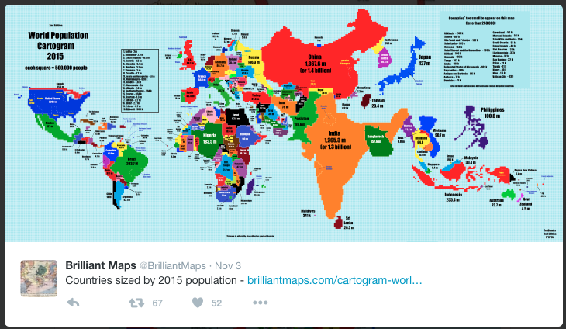
Maps
Can combine with other graphics, overlays

Slide 38
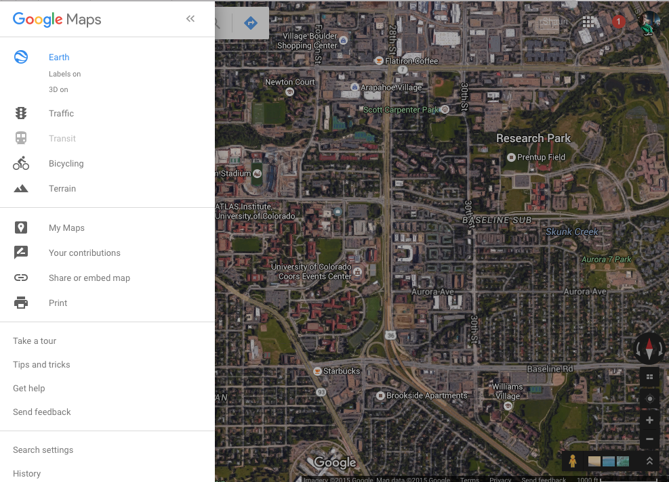
Map layering

Slide 39
Timelines

Slide 40
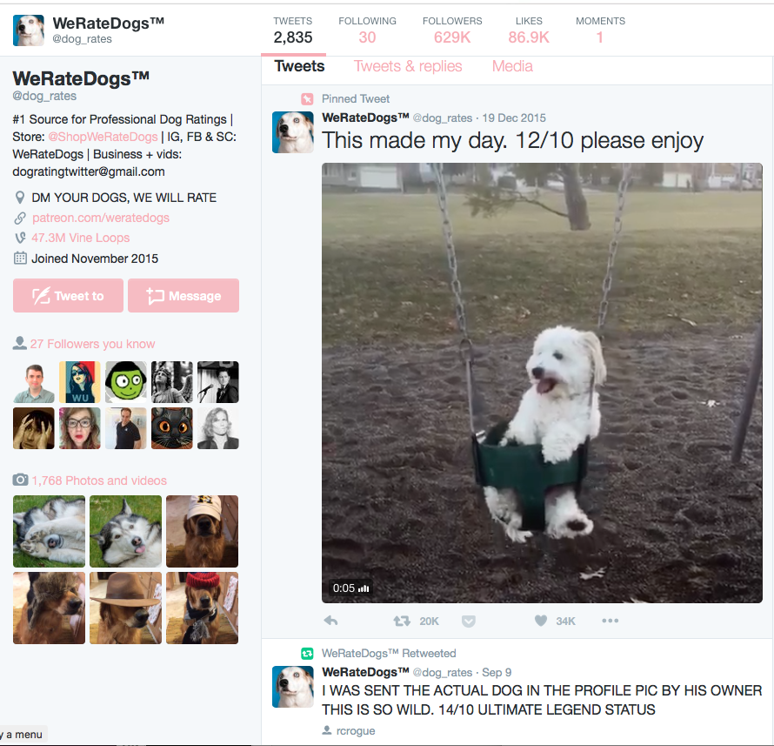
The other kind of timeline

Slide 41
Small multiples
Allow comparisons between similar data
Notes:
https://www.propublica.org/nerds/item/design-principles-for-news-apps-graphics

Slide 42
Photo collages or “image quilts”
Enable overviews of available information

Slide 43
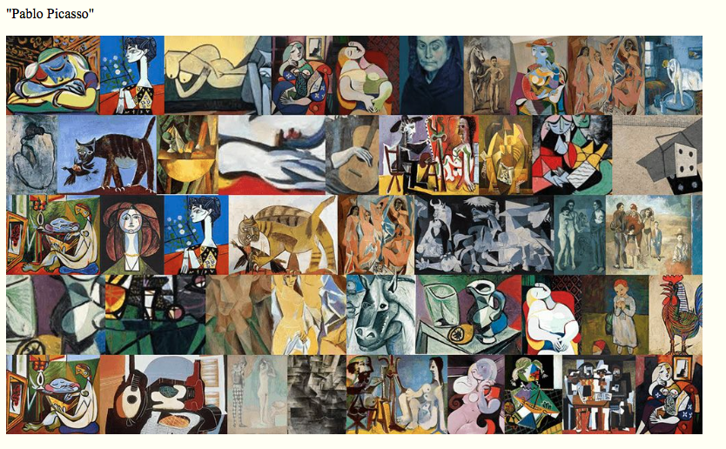
Notes:
From Tufte

Slide 44
Treemaps
Show relative importance of data in a condensed space
Invented by Prof. Ben Schneiderman, University of Maryland

Slide 46
Sparklines
Represent small quantitative data in context
Invented by Tufte

Slide 47
Why use a certain representation?
Imagine we have data about food that a person has eaten. What would the following representations allow us to see?
Charts
Maps
Timelines
Multiples
Photo collages
Sparklines

Slide 48
Sometimes text is better
Notes:
iOS Face Dialer

Slide 49
Accessibility challenges
Notes:
Type size, color. Visual literacy.

Slide 50
Non-visual representation
How to represent data non visually?

Slide 51
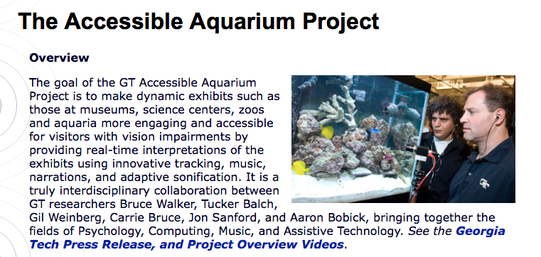
Sonification of data
Map data to pitch, stereo, other factors

Slide 52
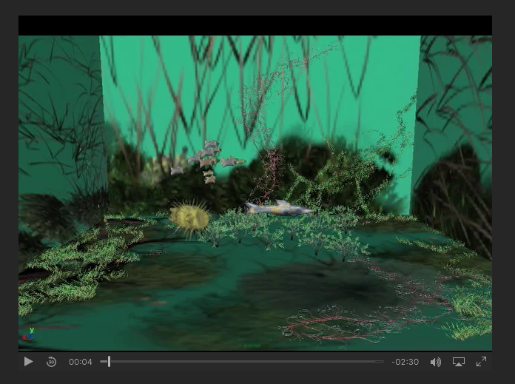
http://sonify.psych.gatech.edu/research/aquarium/

Slide 53
Challenges of sonification
Requires training
Limited bandwidth for simultaneous transmission

Slide 54
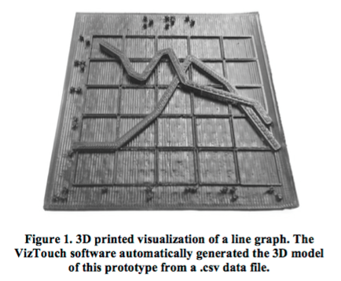
Tactile representations
Amy Hurst et al., VizTouch

Slide 55
Challenges of tactile representations
Limited bandwidth
Production can still be challenging

Slide 56
Multimodal representations
Combine visual with sound, tactile, etc.
More engineering required, but can be more universally usable

Slide 57
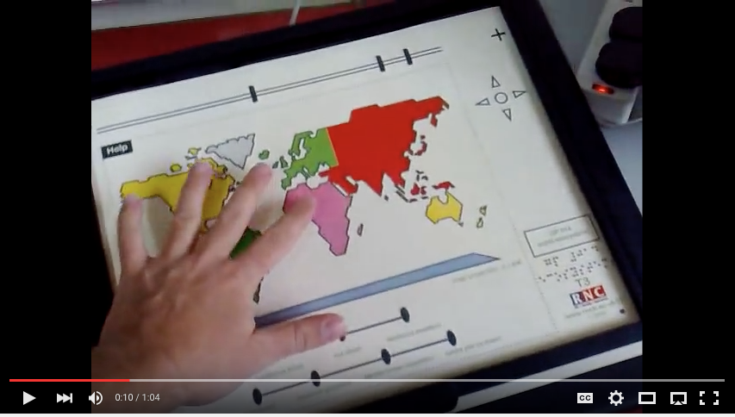
Talking Tactile Tablet
https://www.youtube.com/watch?v=MEU1XbTH1Ts

Slide 58
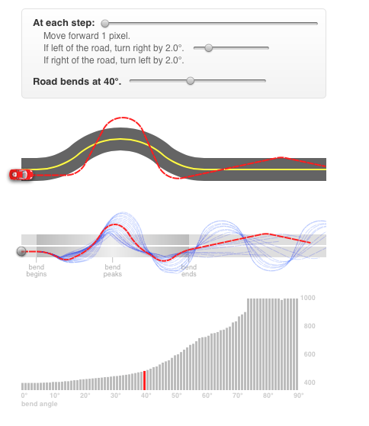
Interactive visualizations
Can limit information overload
Can enable hypothesis testing
Make interaction part of learning (rather than using it to overcome poor design)
http://worrydream.com/#!2/LadderOfAbstraction
http://phet.colorado.edu

Slide 59
Deceptive visualizations 😈
Can our information representations be misleading?

Slide 60
Lying with data
Deceiving scales
Showing data on two different scales
Spurious correlations
Ignoring important variables (e.g. scale)
Deceiving visual representation
Notes:
Examples from http://news.nationalgeographic.com/2015/06/150619-data-points-five-ways-to-lie-with-charts/

Slide 61
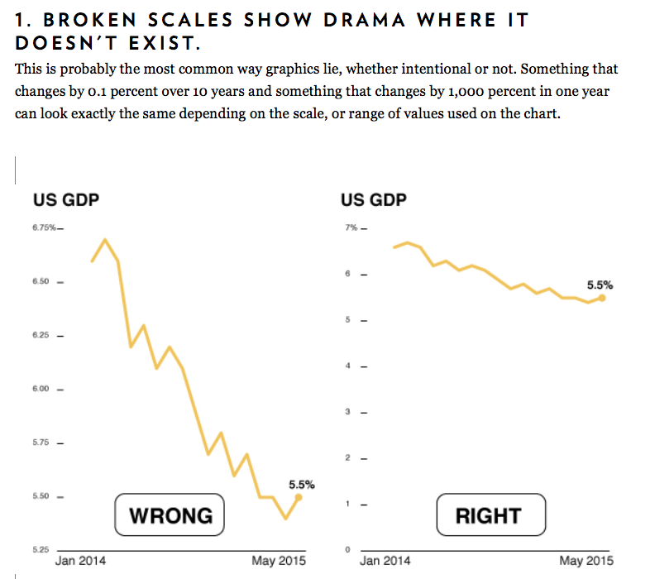
Notes:
http://news.nationalgeographic.com/2015/06/150619-data-points-five-ways-to-lie-with-charts/

Slide 62
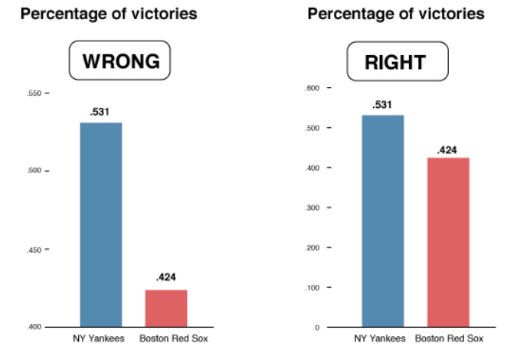

Slide 63
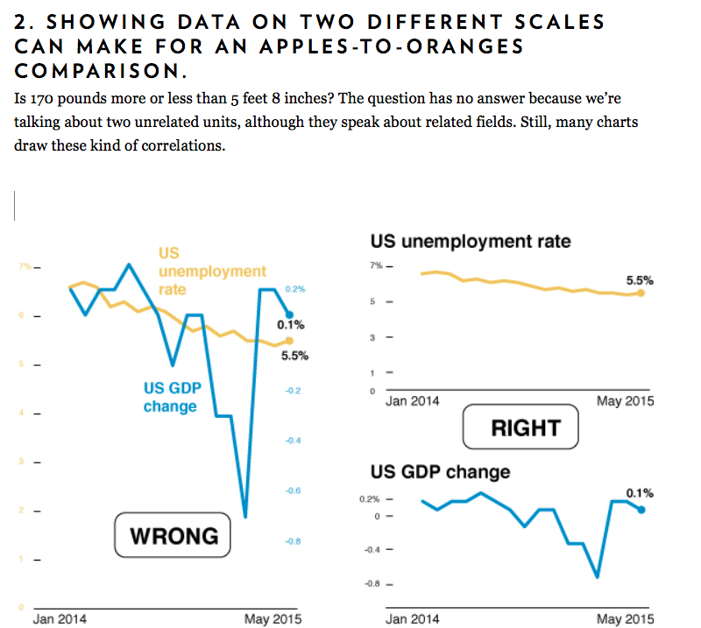

Slide 64
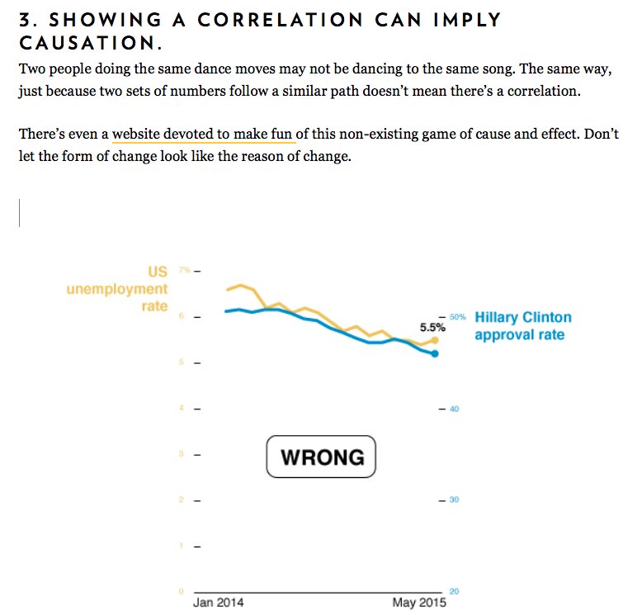

Slide 65
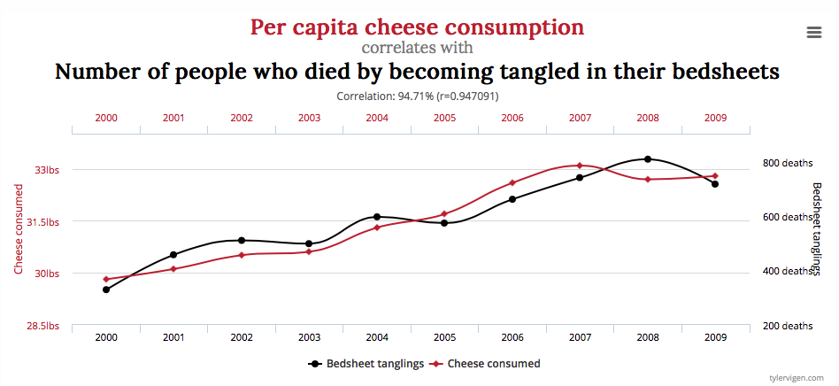
http://www.tylervigen.com/spurious-correlations

Slide 66
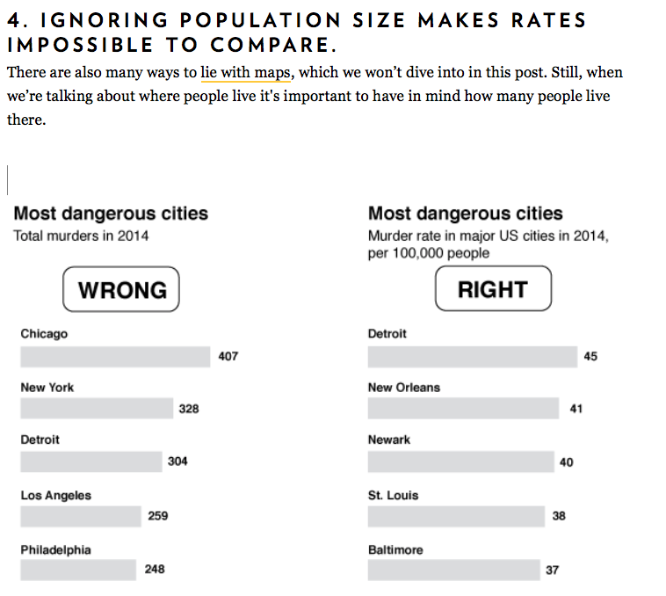

Slide 67
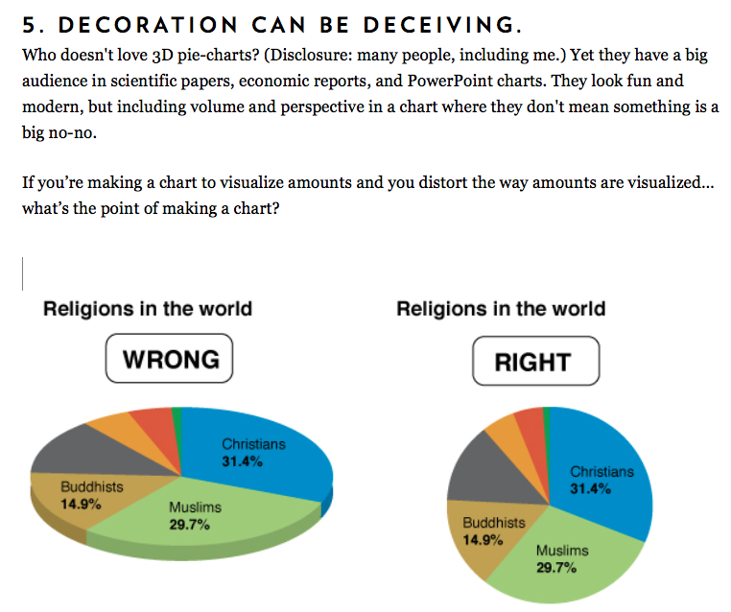

Slide 68
What to do about misleading visualizations?
Train yourself to recognize common tricks
Consider how the same information might be presented differently, and what that might show
In your work, be mindful of what your goal is (and what you want to communicate)

Slide 69
References on data representation
Edward Tufte, http://www.edwardtufte.com
Scott McCloud, Understanding Comics
http://informationisbeautiful.net
http://feltron.com/
http://reddit.com/r/DataIsBeautiful
http://reddit.com/r/DataIsUgly
http://viz.wtf

Slide 70
Data to visualize
Social check-in data (but OK to bring in other data)
At the top, write why we care about this data
User | Location | Latitude | Longitude | Start Time | End Time
Shubham | C4C | X1 | Y1 | S1 | E1
Lise | Ozo Coffee | X2 | Y2 | S2 | E2
Shaun | Boxcar Coffee | X3 | Y3 | S3 | E3
Shubham | Norlin Library | X4 | Y4 | S4 | E4

